Slide 1
Markets
Chapter 9

Slide 2
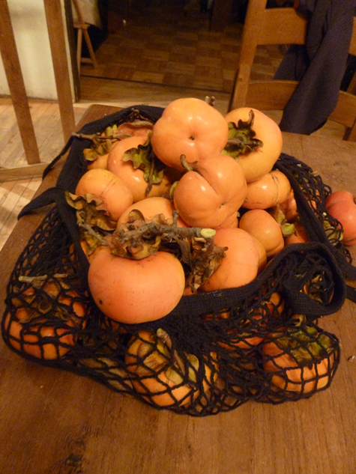
Free Persimmons!

Slide 3
Why on Earth Would an Economist Give Away
Free Persimmons?
√ Got a bumper crop
√ Neighbors got a bumper crop
√ Can’t sell at farmers’ market
  Not certified organic
  Not sure how to do it
  Costs money, right?
√ Can’t sell around town
  Who has time (or a cart)?
  Probably illegal; traceability
  Health regulations, etc.

Slide 4
Or Are They Really Free?
No economist thinks people give gifts for free
Gift-giving in poor villages
  Pervasive (has to be on our survey forms!)
  Cements social ties that can help out when the crop fails, kids get sick, etc.
  Reciprocation as (informal) insurance
Will I get a chili pepper this quarter?

Slide 5
What’s a Market?
mar·ket /ˈmärkit /
An open place or a covered building where buyers and sellers convene for the sale of goods (Dictionary.com)
A meeting together of people for the purpose of trade… a public place where a market is held (Merriam Webster)
A regular gathering of people for the purchase and sale of provisions, livestock, and other commodities (Oxford)
Where does ebay fit in?
There’s a farmers’ market in my town, but that didn’t help me with my persimmons…

Slide 6
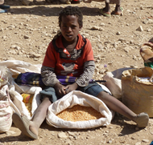
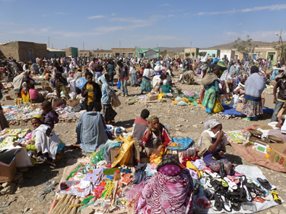
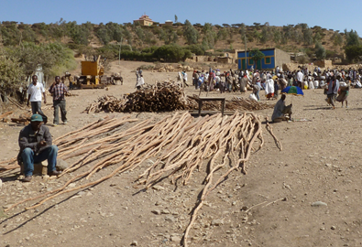
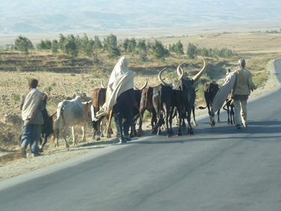
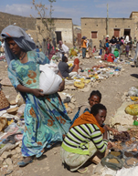
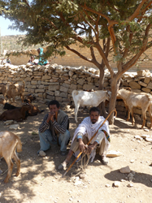
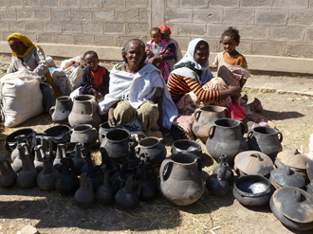
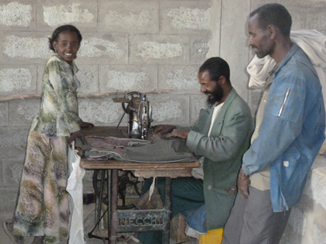
Images from a Tigray (Ethiopia) Market

Slide 7
Markets Are Where
Buyers and sellers “discover” one another
  It doesn’t have to be a farmers’ market
  ebay or Safeway
Price discovery happens
More broadly: An infrastructure and set of institutions that facilitate the transfer of property rights from one person to another
  Simple for a persimmon
  More complicated for real estate, a loan, or insurance policy

Slide 8
Yet Millions of Smallholders Opt Out of Markets—Why?
“The institutional and physical infrastructure necessary to ensure broad-based, low-cost access to competitive, well-functioning markets” requires “significant investment, typically by the public sector, paid for out of tax revenues or aid flows.
One thus has to get institutions and endowments, as well as prices, ‘‘right” in order to induce market-based development.
Chris Barrett, Food Policy 33 (2008) 299–317

Slide 9
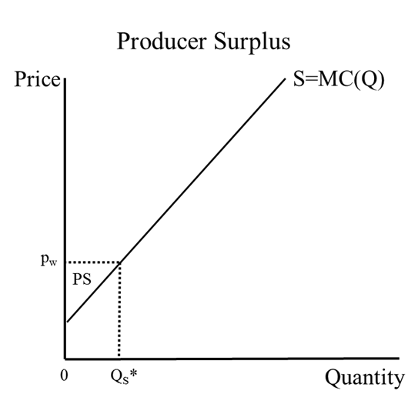
Welfare Basics: Producer Surplus
Producer surplus is given by the area between price and the supply curve
  Our measure of producer welfare

Slide 10
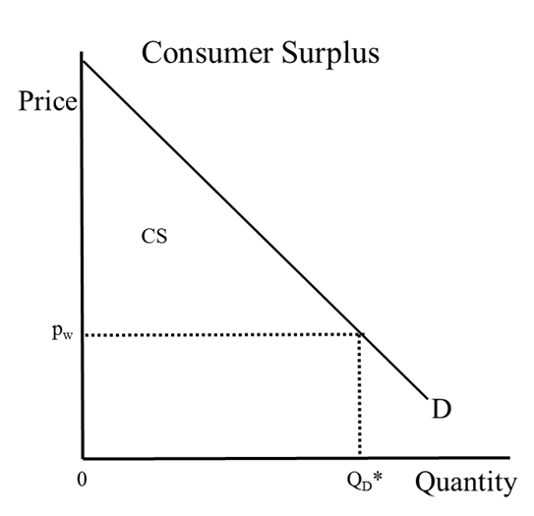
Welfare Basics: Consumer Surplus
Consumer surplus is given by the area between the demand curve and price
  Our measure of consumer welfare

Slide 11
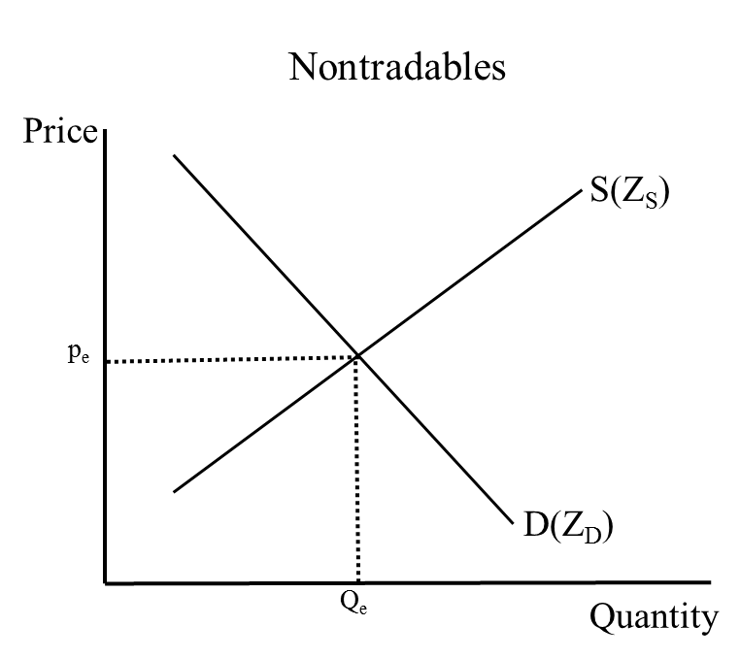
Price Discovery
•The intersection of supply and demand give the equilibrium price and quantity for a nontradable in the economy (nation, region, household)
•Everything in Z_{S} and Z_{D} is reflected in the price (see boxes: “All in One Price” and “Estimating the Shadow Price of Corn”)

Slide 12
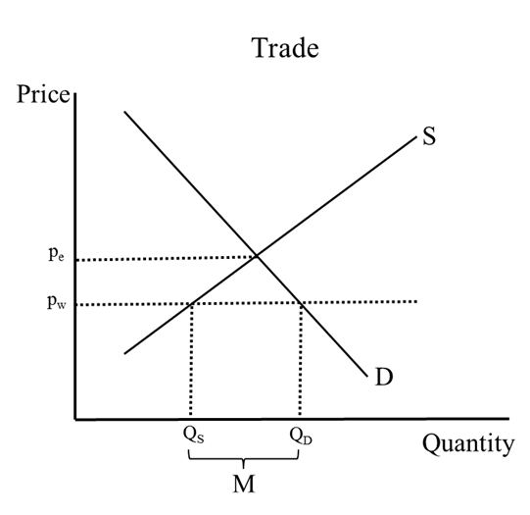
Trade “Decouples” Local Supply from Demand for Tradables
At world price p_{w}, the economy supplies Q_{S} and demands Q_{D}
The difference, M, is imports
Producers lose “Producer Surplus” (A)
…but consumers gain more (“Consumer Surplus” = A+B)
A
B

Slide 13
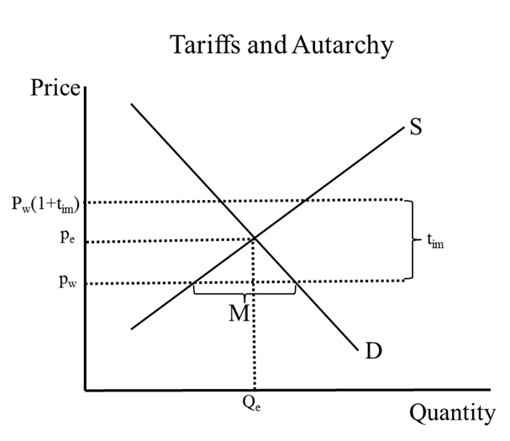
A High Import Tariff Can Drive the Country into Autarky
Import tariff: t_{im} per unit
…So consumers would have to pay p_{w}(1+ t_{im}) for imports
They’re better off paying the autarkic price, p_{e}
The tradable becomes a non-tradable, i.e., it is no longer traded with the rest of the world

Slide 14
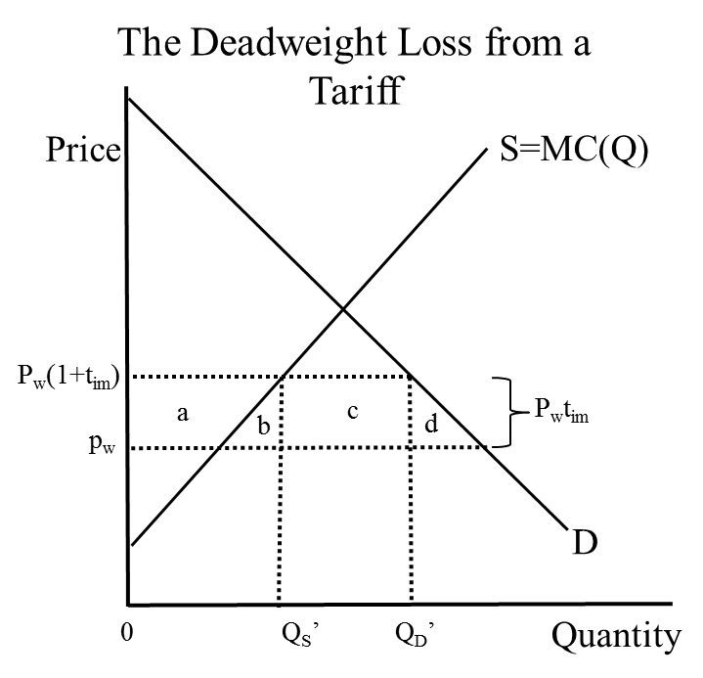
Tariffs Create a “Deadweight Loss”
The lost consumer surplus is (a+b+c+d)
The government gets the tax (c)
The gain in producer surplus is (a)
What happened to (b+d)?
  It’s the efficiency cost of the tariff, or deadweight loss
Without the tariff everyone could be better off!

Slide 15
Within Countries, Transaction Costs Create a “Deadweight Loss” and Turn Tradables into Nontradables
P_{r} – regional price (i.e., in nearest market)
In an isolated village transaction costs are t_{c} per unit for consumers and t_{p} for producers
  Consumers must pay p_{r}(1+ t_{c})
  Producers get p_{r} (1- t_{p})
If the local equilibrium price p^{e} falls within this “price band,” both buyers and sellers are better off not transacting with outside markets, given transaction costs
  …so the economy will be in autarky
  …with deadweight losses like with import tariffs

Slide 16
The Village As Price Taker in the Regional Berry Market
Village Berry Market
Regional Berry Market
Price
Price
S_{v}
S
p_{r}
p_{r}
p_{v}
D_{v}
D
Q_{v}
Q*
Quantity
Quantity
Sales to Region

Slide 17
High Transaction Costs Drive Village Berry Farmers Out of the Market
Village Berry Market
Regional Berry Market
Price
Price
S_{v}
S
p_{r}
p_{r}
Transaction cost t_{p}
p_{v}
p_{r}-t_{p}
D_{v}
D
Q_{v}
Q_{r}
Quantity
Quantity
With high transaction costs: Village berry sales to the region are zero.

Slide 18
High Transaction Costs Drive Village Berry Farmers Out of the Market
Village Berry Market
Regional Berry Market
Price
Price
S_{v}
S
p_{r}
p_{r}
A
B
Transaction cost t_{p}
p_{v}
p_{r}-t_{p}
D_{v}
D
Q_{v}
Q_{r}
Quantity
Quantity
The lost producer surplus is A+B, and the gain in consumer surplus is B.

Slide 19
High Transaction Costs Drive Village Berry Farmers Out of the Market
Village Berry Market
Regional Berry Market
Price
Price
S_{v}
S
P_{r}+t_{c}
t_{c}
p_{r}
p_{r}
A
B
Transaction cost t_{p}
p_{v}
p_{r}-t_{p}
D_{v}
D
Q_{v}
Q_{r}
Quantity
Quantity
Consumers face transaction costs, too. In this case it doesn’t change the outcome—why?

Slide 20
Imperfect Information Causes High Transaction Costs
Von Hayek: Prices convey information (see “All in One Price” box)
George Akerlof: The Market for Lemons
  Asymmetric information can kill markets (see “Selling Green Beans to Europe” box; I need to certify my persimmons!)
Poor roads and communications cut the buyer and seller off off from information about each other
  where to sell (or buy)
  when to sell (or buy)
  how to ensure quality
  the price you’ll get (or pay)
Markets fail when it’s too costly to solve the information problem

Slide 21
The Fundamental Problem of High Transaction Costs in Poor Economies
With high transaction costs different producers face different prices
  …and thus produce at different MCs
The same thing happens to consumers
  …they consume at different marginal rates of substitution
Efficiency could be increased by reducing or eliminating transaction costs, so that trade can equalize prices across markets (see “Saving Fish with Cell Phones” box)
Market failure happens when people can’t get together to make efficiency-enhancing trades
  Extreme transaction costs: Civil war (see “Famine and Missing Markets in Tigray”)

Slide 22
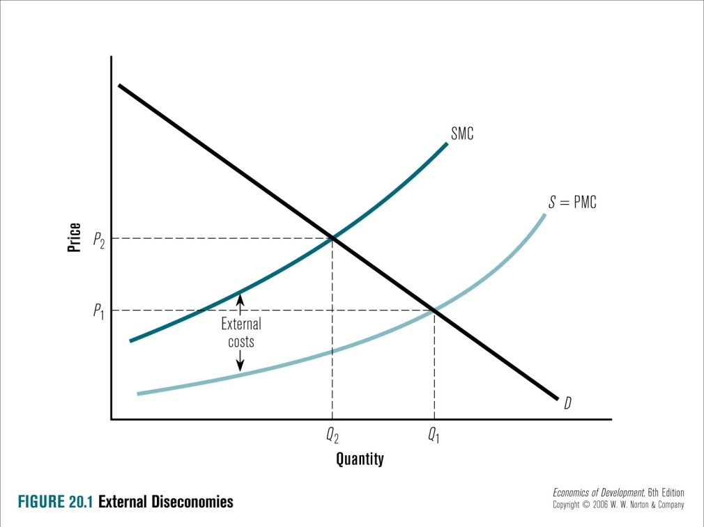
Externalities
Classic case where market doesn’t happen: externalities
Agents do not take account of the social costs of their actions
  only the private costs and benefits
  Climate Change: Making a market for CO²
The socially optimal quantity is where the social marginal cost equals marginal benefit (demand)
The private optimum is where the private marginal cost equals marginal benefit
The (vertical) difference represents the external costs

Slide 23
On Globalization
“This has created many new opportunities, but also new questions regarding the roles, functions and core capacities of the various key players. Deep-rooted principles and paradigms have been cut down in a short period. It is sometimes like mixing an Italian basketball team with Nigerian soccer players, and trying to play in a volleyball tournament. The new situation raises many questions about how the game is played, and who are the winners and losers.” (KIT, 2006)

